Slide 1
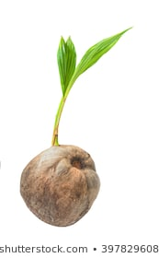
Question 1 : What will this seed grow in to?

Slide 2
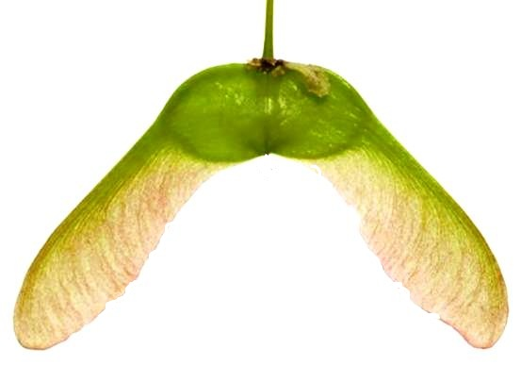
Question 2 : What will this seed grow in to?

Slide 3
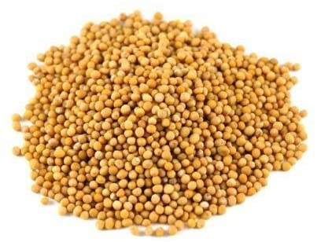
Question 3 : What will these seeds grow in to?

Slide 4
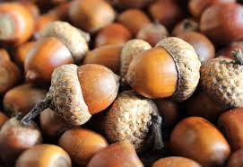
Question 4 : What will these seeds grow in to?

Slide 5
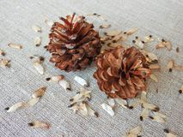
Question 5 : What will these seeds grow in to?

Slide 6
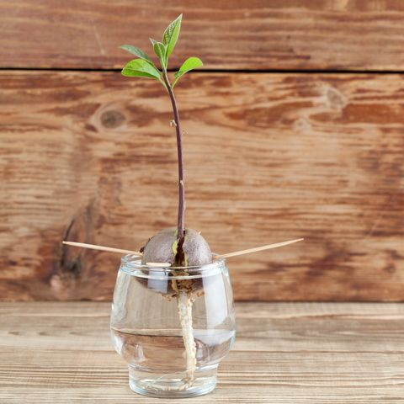
Question 6 : What will this seed grow in to?

Slide 7
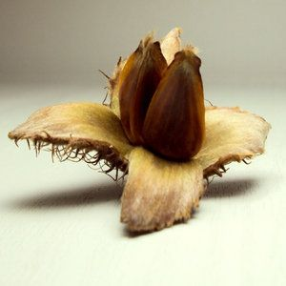
Question 7 : What will this seed grow in to?

Slide 8
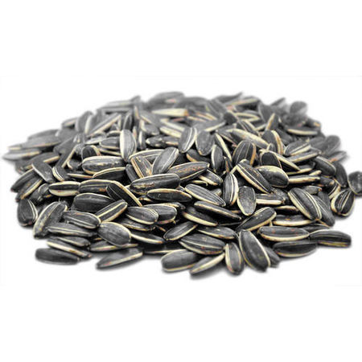
Question 8 : What will these seeds grow in to?

Slide 9
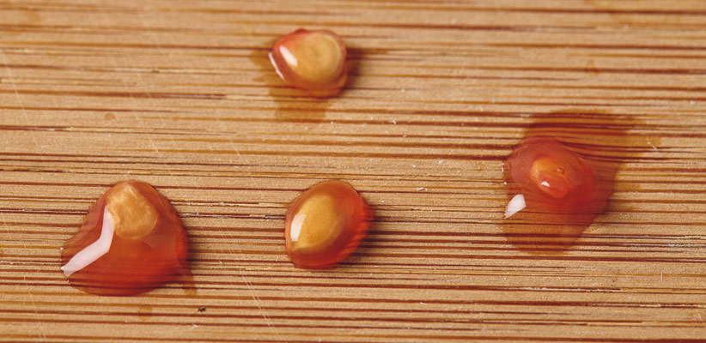
Question 9 : What will these seeds grow in to?

Slide 10
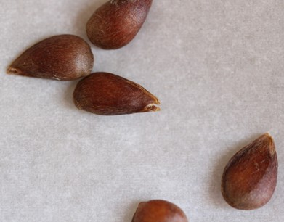
Question 10 : What will these seeds grow in to?

